Slide 1
Top Bitcoins Price Data Analysis
Created by:
Erna Mercier

Slide 2
Content.
Idea of the project.
Tutorials to use API and collect data.
Code to get the first result and start of the project.
Iteration of the same steps to get data for multiple observations.
Data Exploration charts.
Use of coding communities to explore the relevant data
Challenges and further expectations.

Slide 3
Roadmap
Idea
Python and it’s libraries
Dataset of current values
1
3
5
2
4
6
Use of
API
Top Bitcoin values
Data Exploration

Slide 4
Idea
This project circle around the prices of top bitcoins in the market, I will import the prices through API and visualize it in Python.
Dataset exploration will help us to understand the pricing patterns.
1

Slide 5
Tutorials and help for data import:
Thanks to my classmate Eric Guarre who found the appropriate API and team members: Yesake Abaye, Mumbi Kairu, and Usen-Usen.
The documentation available at www.Crypocompare.com
YouTube video tutorial to get data in python.
Use of website API to get the data.

Slide 6
Technical requirements.
The analysis was done with Jupyter Notebook(Anaconda).
All the libraries were installed through Anaconda.
Used libraries(Main):
Library | Purpose
Pandas | Data Manipulation
Seaborn/matplotlib | Visualization
requests | Data from internet
Numpy | Numerical values
re | To deal with symbols

Slide 7
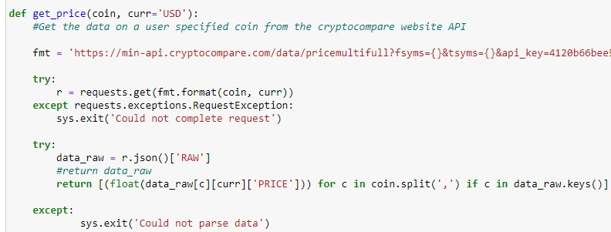
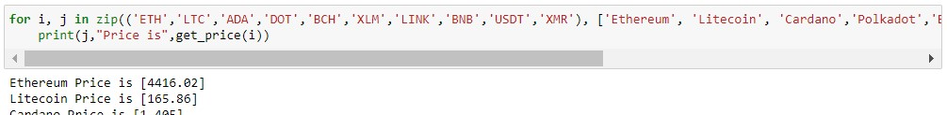
Code of first step and
Setup the API and access the required data.
The below code chunk was used to import the libraries and connect with bitcoin prices API.
A for loop generated the current prices.

Slide 8
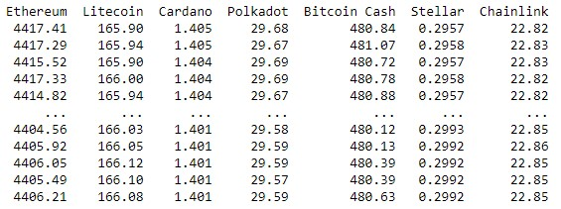
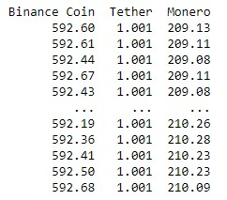
Iteration of same steps for data
Now, to get the dataset of all these bitcoins I iterated the same loop 100 times to get the data.
The data came in a number series format then it was converted in matrix form.
The matrix further converted in data format and column names were assigned for all the bitcoins.
After all these steps, we get the final data, see below:

Slide 9
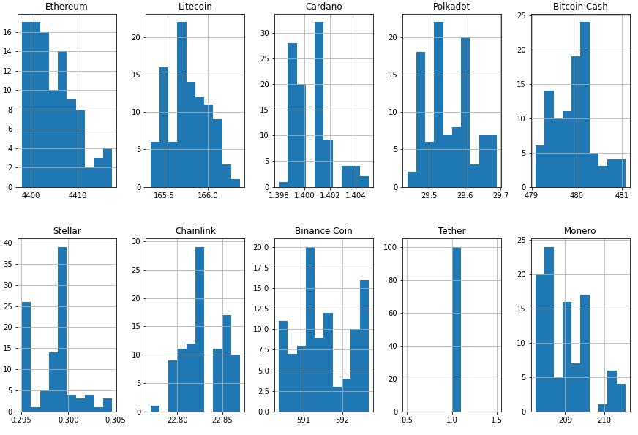
Data Exploration
With the data exploration we can identify some of the important results
This histogram tells us about the distribution of prices and min and max of prices for the current time.
We observed that tether pricing did not change at all.
One can consider this for trading decisions.

Slide 10
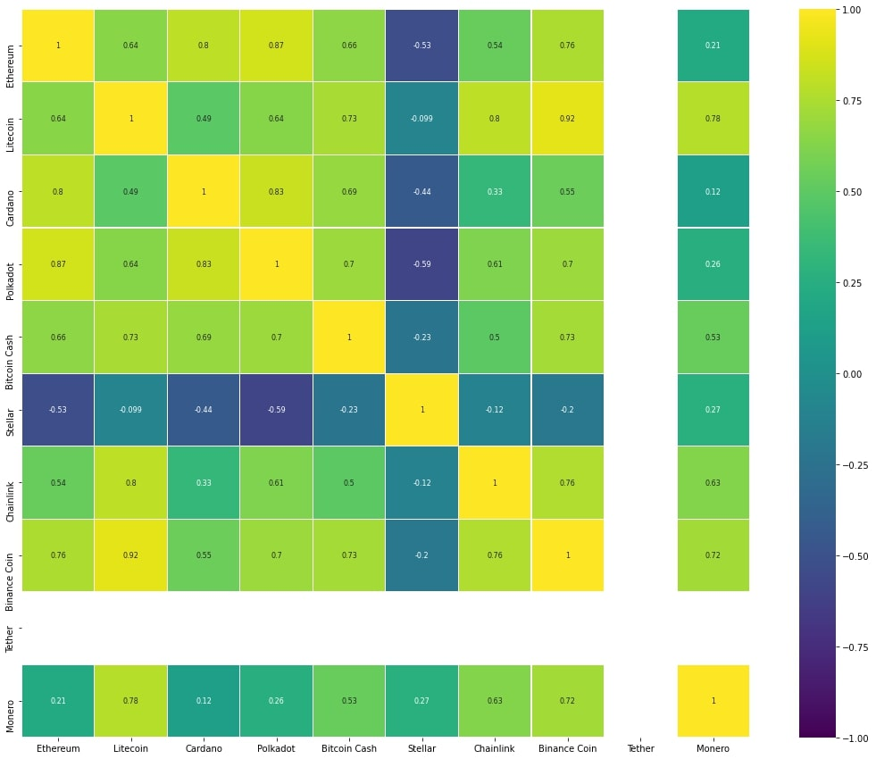
Correlation between Bitcoin pricing
Correlation: We can identify the movement of pricing on bitcoin when other bitcoin price changes
Correlation varies between -1 to 1 and these values and considered to be a good relationship value.
Negative values represent a negative relationship. If one price increase, others will decrease.

Slide 11
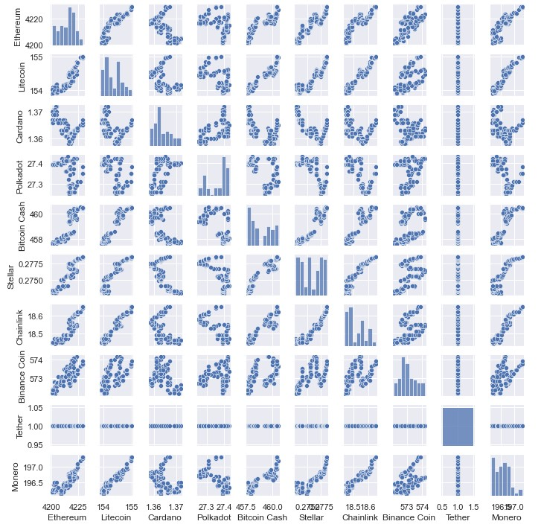
Scatter plot
Scatterplot also shows the relationship between variables.
Closer points represent a high degree relation with values closer to -1 or 1.
Movement of points demonstrates the type. Diagonally scattered points are positively related while non-diagonal are negatively related.
Points with no direction represent no relationships and their correlation value will be 0.

Slide 12
Challenges and Further expectations
The loop fetched the current price values without change. Repeated values were not required. In one operation to make for loop, wait for seconds and applied a 5 second break.
The main challenge is the required time and computation power because the collected data is based on current time. The more time required to collect more data.
Due to this limitation, only 100 price values for each price were observed.
We can use this analysis for real time analyzation of bitcoin prices to assist investors to make investment decisions.
Since the analysis is current time data, therefore one can see the current fluctuations in the pricing and trade the bitcoins accordingly.

Slide 13

Thank you

